Slide 1
CYBERSECURITY LAB • WEEK 1
Kali Linux Lab Setup
VirtualBox, NAT Networking, IP Configuration and Troubleshooting
A practical project report
Prepared as a hands-on lab record

Slide 2
1. Project Overview
What I am setting up and why
VirtualBox
Kali Linux
NAT Network
VirtualBox lets me run Kali Linux as a virtual machine on my Windows laptop.
Kali provides tools for learning cybersecurity and practicing security testing.
A NAT Network connects lab virtual machines while providing network access.
• The goal is to build a stable, isolated practice environment.
• This report covers network setup, IP configuration, connectivity checks and recovery options.
• All testing should stay within my own lab or systems I have permission to test.
02

Slide 3
2. Target Configuration
Values used for this lab
Virtualization platform
Oracle VirtualBox
Network mode
NAT Network
Network prefix
10.0.0.0/24
Kali IPv4 address
10.0.0.2/24
Connectivity
Gateway, internet and DNS checks
Clipboard and drag-and-drop
Bidirectional, if supported
Shared folder
Optional, configured separately
Recovery point
Snapshot after successful verification
03

Slide 4
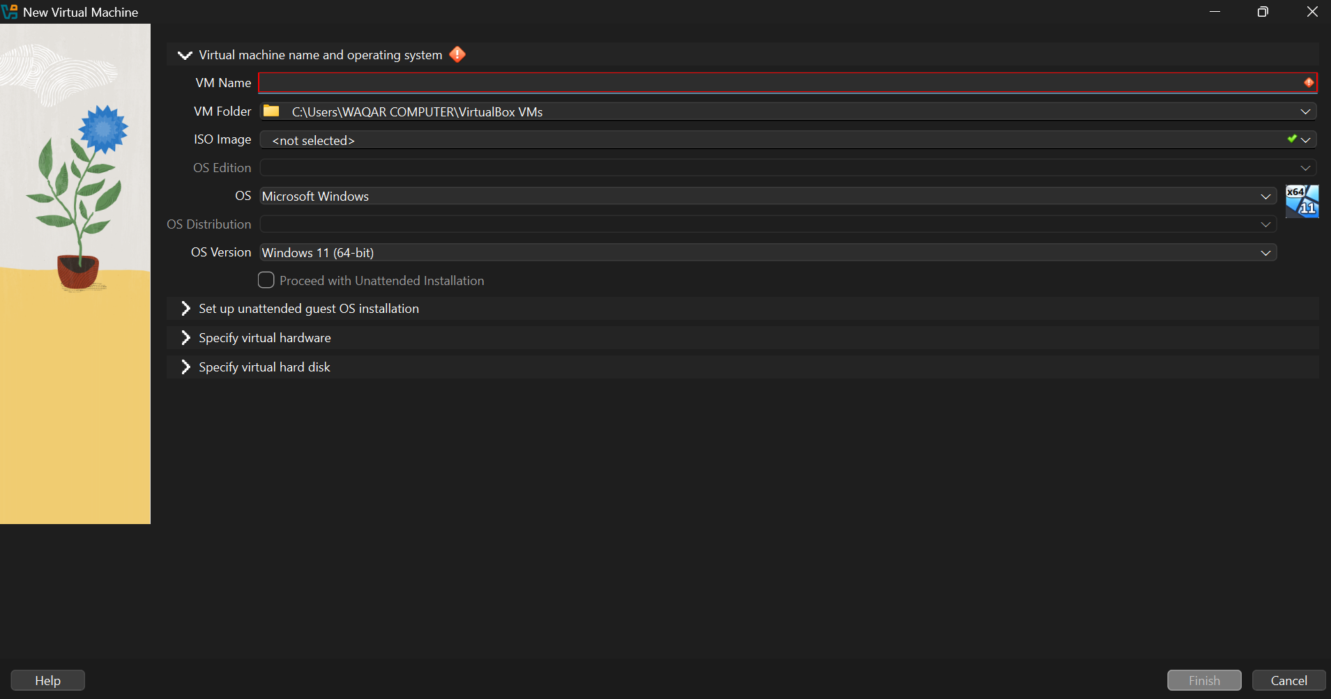
3. Creating a Virtual Machine
The screenshot shows the New Virtual Machine window
What I noticed
The VM Name field is empty and no ISO image is selected.
How to resolve it
If Kali is already installed or imported, select the existing VM instead of creating another one. If creating a new VM, enter a name and select the correct Kali ISO.
The Finish button stays disabled until required fields are completed.
04

Slide 5
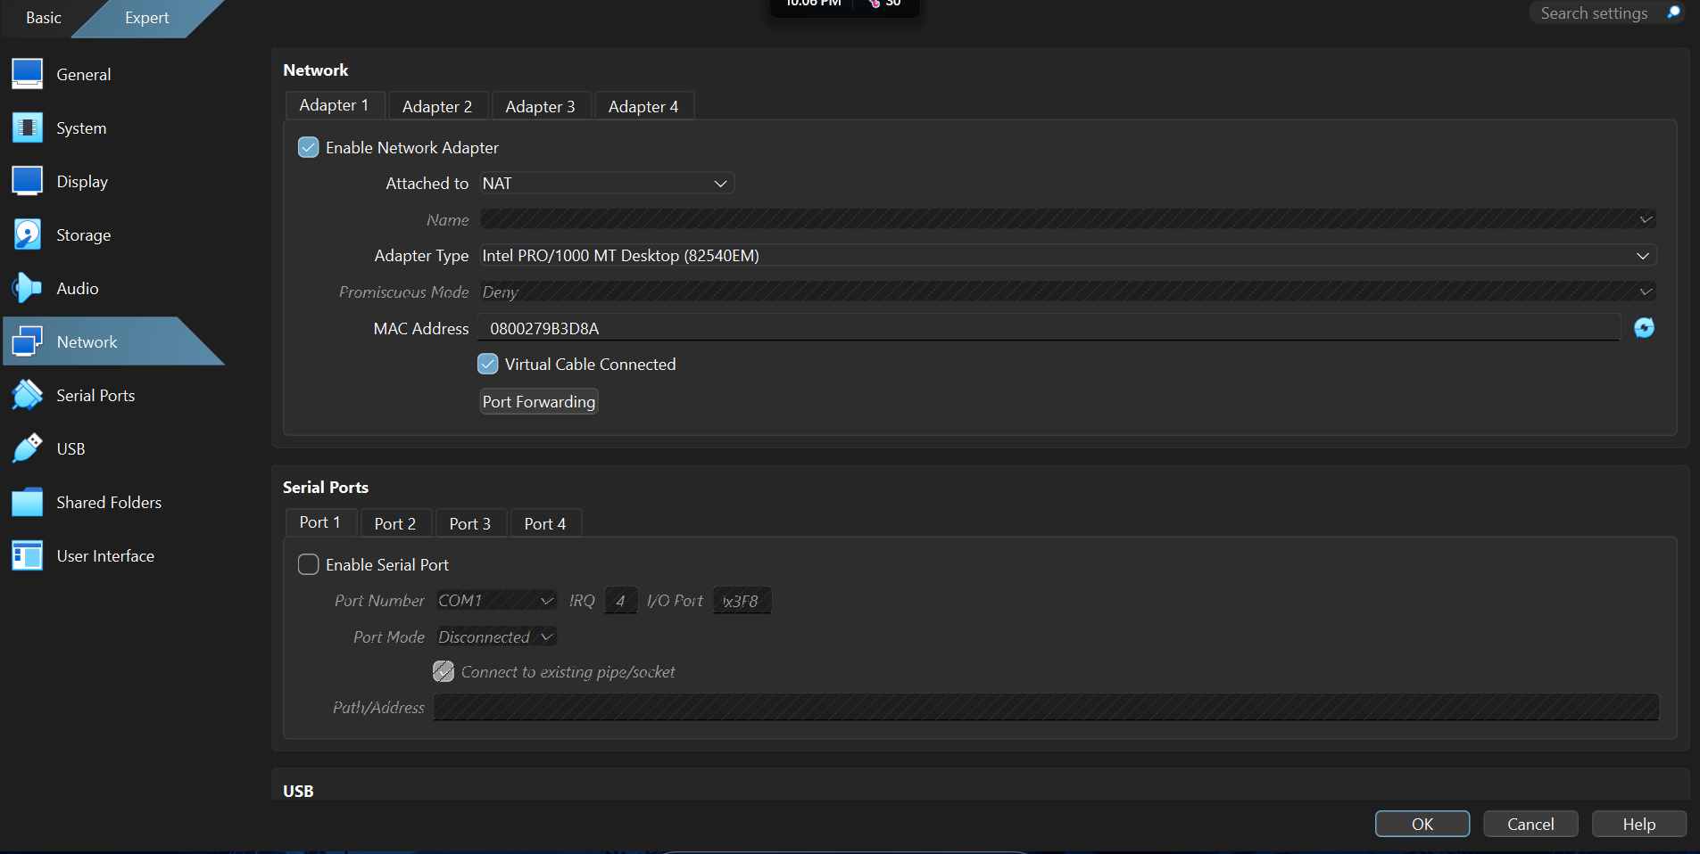
4. Choosing the Correct Network Mode
The screenshots show both NAT and NAT Network
Standard NAT
This mode gives the VM outbound access through the host, but it is not the named NAT Network requested for this lab.
Required setting
Choose NAT Network in the Attached to menu, then select the network name from the Name list.
Keep Adapter 1 enabled and Virtual Cable Connected checked.
05

Slide 6
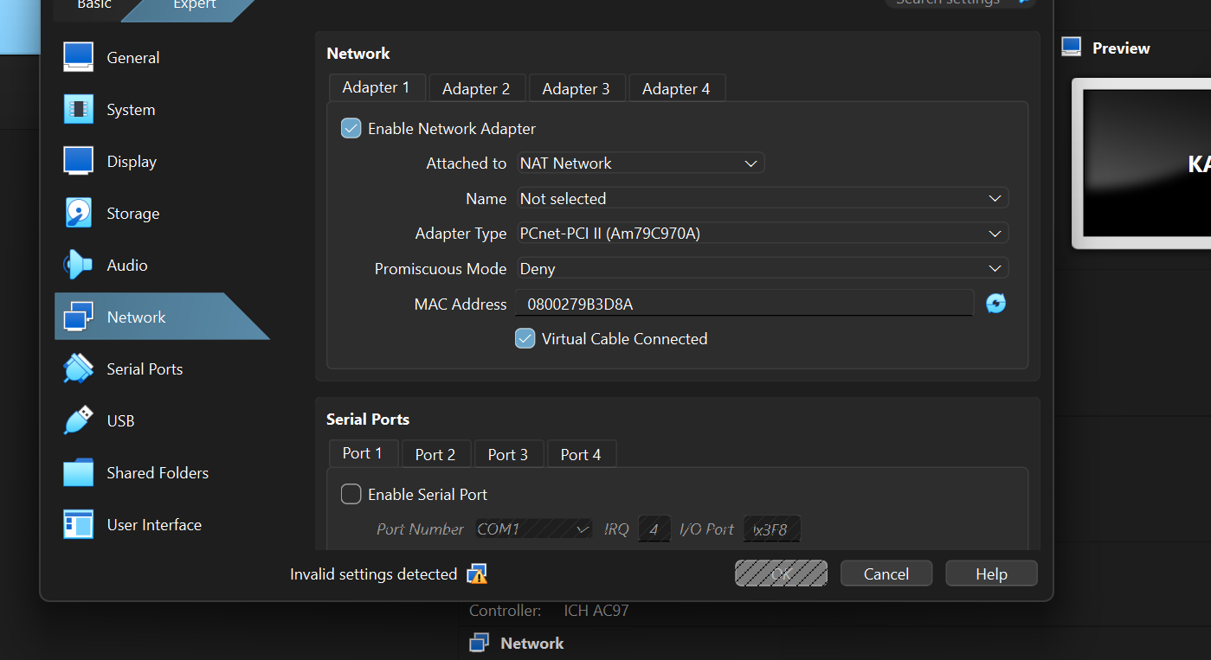
5. Problem: No NAT Network Selected
The adapter is set to NAT Network, but its Name field is empty
Why it happens
VirtualBox needs an existing NAT Network to be selected.
Steps to fix it
1. Cancel the settings window.
2. Open VirtualBox Network Manager.
3. Create a NAT Network.
4. Set the IPv4 prefix to 10.0.0.0/24.
5. Return to the VM settings and select the new network.
06

Slide 7
6. Creating the NAT Network
Shut down Kali before changing the VM's network settings
• Open VirtualBox Manager and go to Tools → Network (menu names may vary by version).
• Open the NAT Networks tab and click Create or the plus button.
• Give the network a simple name, such as KaliLab.
• Set IPv4 Prefix to 10.0.0.0/24.
• Save the settings, then open the Kali VM's Settings → Network.
• Select NAT Network and choose KaliLab in the Name field.
Network vs. host IP
10.0.0.0/24 defines the subnet. 10.0.0.2/24 is the address planned for Kali.
Gateway note
Do not assume the gateway is 10.0.0.1. Check the actual NAT Network settings before assigning it.
07

Slide 8
7. Configuring Kali's Static IP
First identify the actual NetworkManager connection name
Step 1 — List connections
nmcli connection show
Step 2 — Configure the address
Replace CONNECTION_NAME with the exact name shown by the command. Set the address to 10.0.0.2/24 and use the gateway and DNS values appropriate to your NAT Network.
Example format (replace the connection name and verify the gateway first):
sudo nmcli connection modify "CONNECTION_NAME" ipv4.method manual ipv4.addresses 10.0.0.2/24 ipv4.gateway GATEWAY_IP ipv4.dns "1.1.1.1 8.8.8.8"
Step 3 — Reconnect
sudo nmcli connection down "CONNECTION_NAME" then sudo nmcli connection up "CONNECTION_NAME"
08

Slide 9
8. Verifying the Configuration
Run each command separately and record the results
IP address
Confirm 10.0.0.2/24 appears on the correct interface.
ip -4 addr
Routing table
Check the default route and gateway.
ip route
Gateway
Replace GATEWAY_IP with the gateway shown in VirtualBox.
ping -c 4 GATEWAY_IP
Internet
Tests connectivity to an external IP address.
ping -c 4 1.1.1.1
DNS
Checks whether domain names resolve.
ping -c 4 google.com
If a test fails, check the adapter, subnet, gateway, DNS and network status before changing more settings.
09

Slide 10
9. Clipboard, Drag-and-Drop and Snapshots
Useful quality-of-life and recovery settings
Shared Clipboard
Drag-and-Drop
Guest Additions
VM Settings → General → Advanced → Shared Clipboard → Bidirectional.
VM Settings → General → Advanced → Drag'n'Drop → Bidirectional.
If clipboard or drag-and-drop does not work, check whether VirtualBox Guest Additions is installed and working.
• Create a snapshot only after the VM boots and the network has been checked.
• Select the VM → Snapshots → Take, then use a clear name such as Kali-Lab-Setup-Complete.
• Configure any shared folder separately under Settings → Shared Folders.
10

Slide 11
10. Problems and Solutions
A short troubleshooting record
NAT Network name is blank
Create a NAT Network first, then select it in the VM adapter settings.
No internet access
Check the network mode, subnet, gateway, DNS and whether the virtual cable is connected.
IP address conflict
Make sure no other VM is using 10.0.0.2.
Clipboard or drag-and-drop fails
Check Bidirectional settings and Guest Additions; restart the VM if needed.
nmcli command fails
Run nmcli connection show and use the exact connection name.
11

Slide 12
11. Submitting the Project
Prepare the evidence and follow your course instructions
1. GitHub Repository
2. LinkedIn Post
Create a repository and upload the README, steps you completed, and your own screenshots.
Write a short post about what you learned. Tag the requested course account or instructor if required, and add the repository link as instructed.
3. Troubleshooting Notes
4. Submission Form
Describe a real issue you encountered and how you resolved it. Do not claim that a problem was fixed unless you verified the result.
Open the submission form provided by your course and enter the requested details and links. Check your course page for the current deadline.
Use the exact submission requirements provided by your instructor or training program.
12

Slide 13
12. README Template
Edit this to match what you actually completed
# Week 1 — Kali Linux Lab Setup
## Objective
Set up Kali Linux in VirtualBox for an authorized practice lab.
## Planned Configuration
- Network mode: NAT Network
- Subnet: 10.0.0.0/24
- Kali IP: 10.0.0.2/24
## Work Completed
- [ ] Created the NAT Network
- [ ] Connected Kali to the correct network
- [ ] Configured and verified the IP address
- [ ] Tested gateway, internet and DNS
- [ ] Checked clipboard and drag-and-drop
- [ ] Created a recovery snapshot
## Troubleshooting
Problem:
Solution:
Verification:
## Evidence
Add screenshots of your actual settings and test results.
13

Slide 14
13. Final Checklist
Review these items before you submit
• The NAT Network uses 10.0.0.0/24.
• Adapter 1 is attached to the correct NAT Network.
• Kali's IP address and connectivity checks are recorded.
• Clipboard and drag-and-drop have been tested, if required.
• A snapshot was created after verification.
• The GitHub README includes accurate steps and screenshots.
• The LinkedIn post and submission form are complete, if required by the course.
• I have not marked any untested step as completed.
Safety: practice only on systems you own or have explicit permission to test.
14

Slide 15
PROJECT SUMMARY
A working lab is better than a finished checklist.
The next step is to verify the NAT Network, confirm Kali's IP address, test connectivity, and save screenshots of the working setup.
Document what you did, what went wrong, and how you confirmed the fix.
Kali Linux Lab Setup • Week 1

